Slide 1
MIDTERM REVIEW
APS106

Slide 2
Rules of the GAME
Must use button on the table to answer question verbally and explain your answer – you will be called on to answer by one of the instructors
Must tell us which discipline you’re in before you answer for points (we’ll rely on the honour system)
If you get the answer right, you pick the next category
If you get the answer wrong, the next person whose hand is up can steal
Everyone is here to learn and review for the midterm so be kind to everyone who answers!

Slide 3
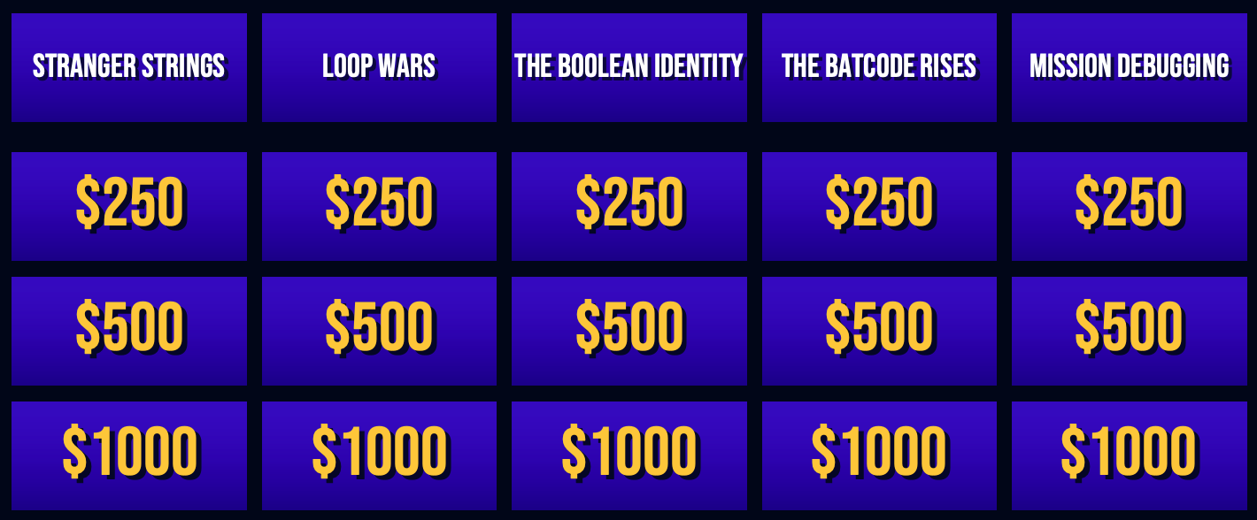
Panel

Slide 4
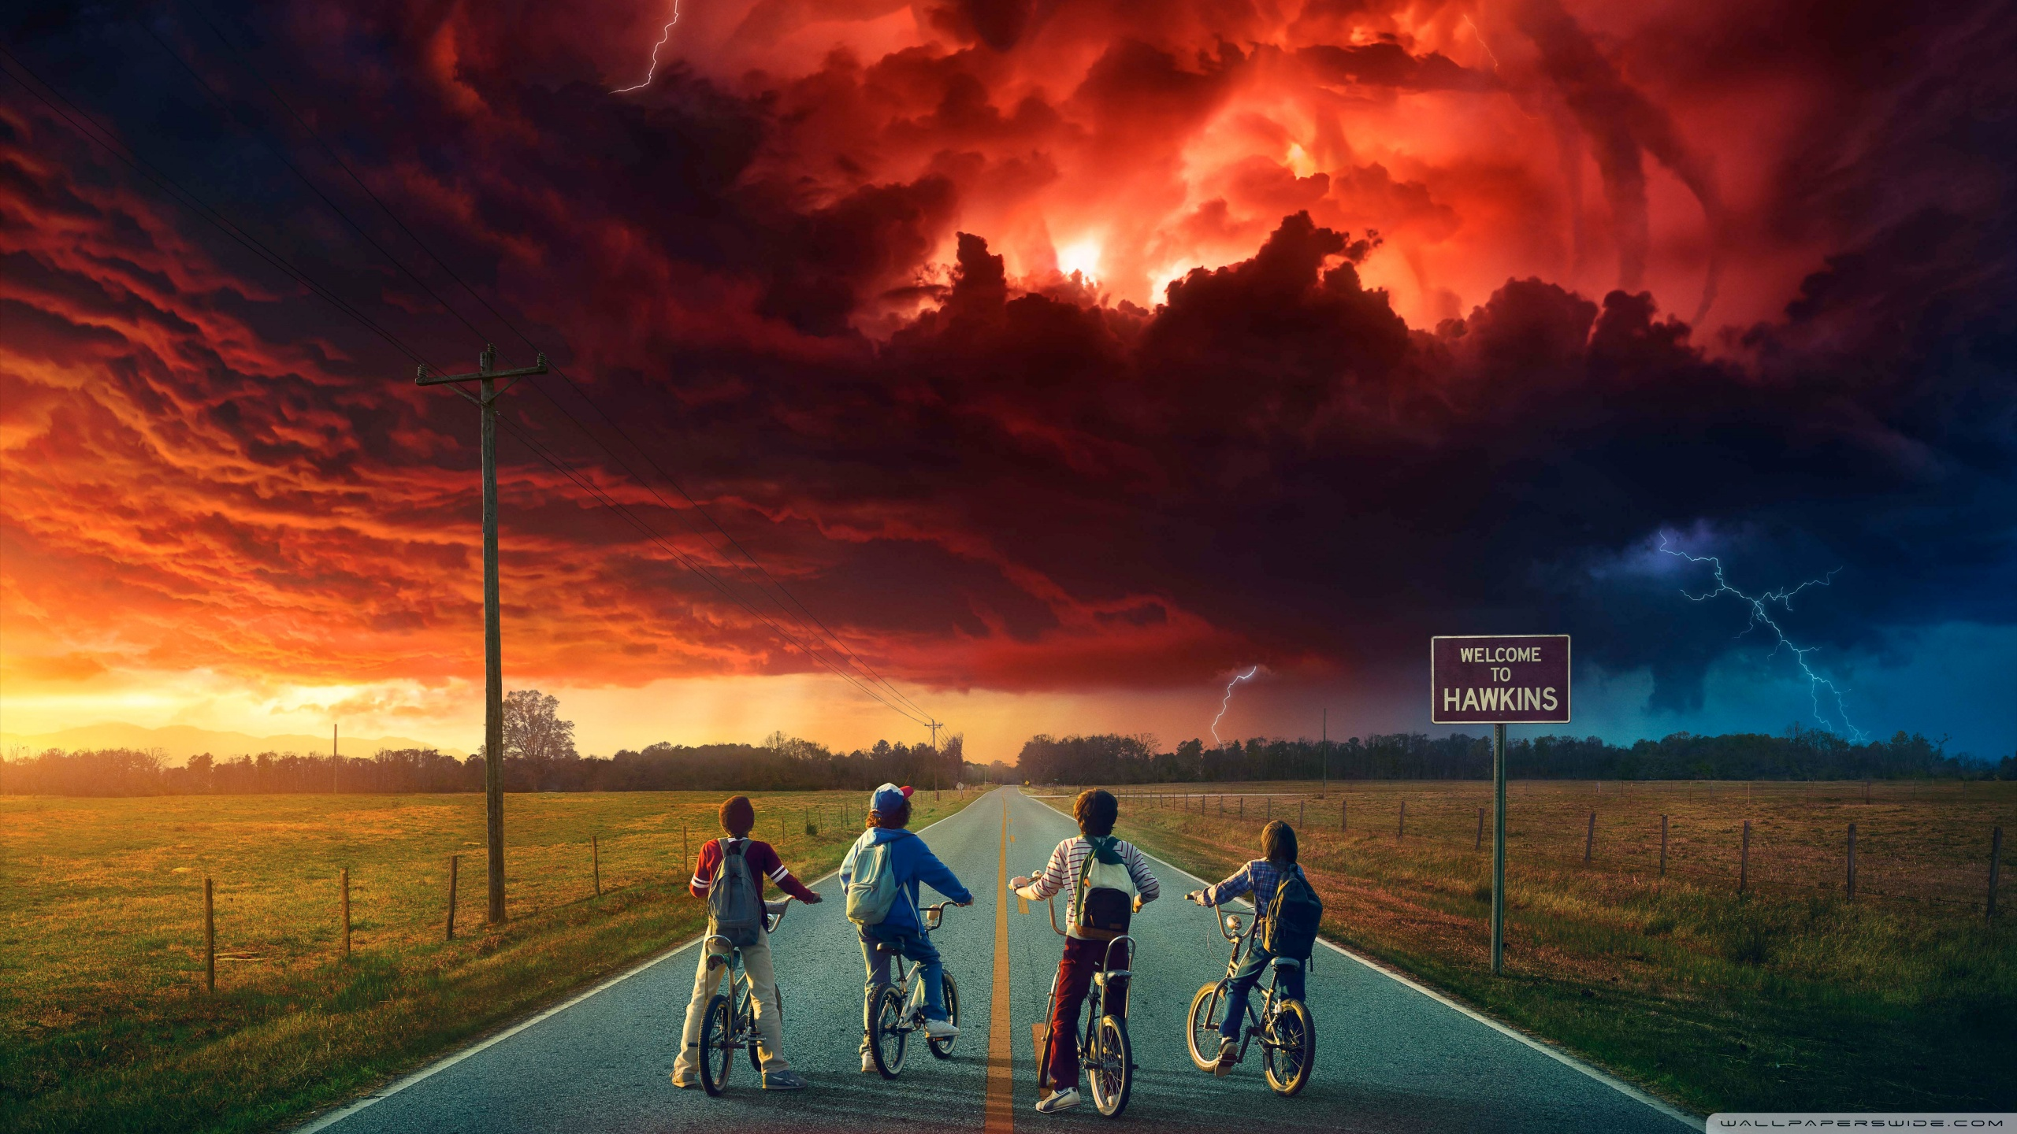
STRANGER STRINGS
"Because Python strings can hide secrets — just like Joyce’s Christmas lights!"

Slide 5

things and strings · $250
What is the output?
Question board

Slide 6
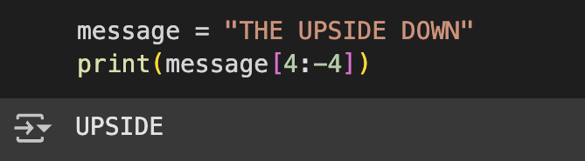
things and strings · $250
What is the output?
Question board

Slide 7
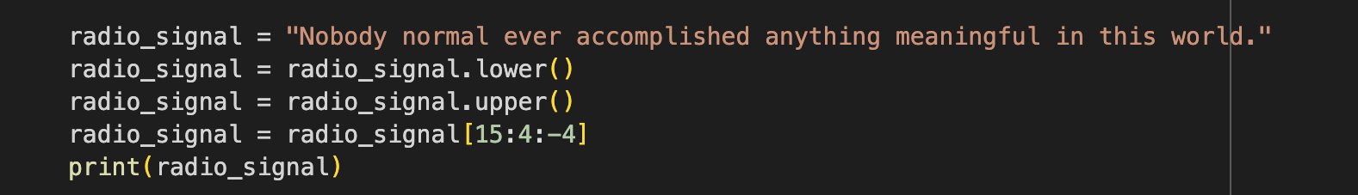
Dustin’s Secret Transmission · $500
What is the output?
Question board

Slide 8
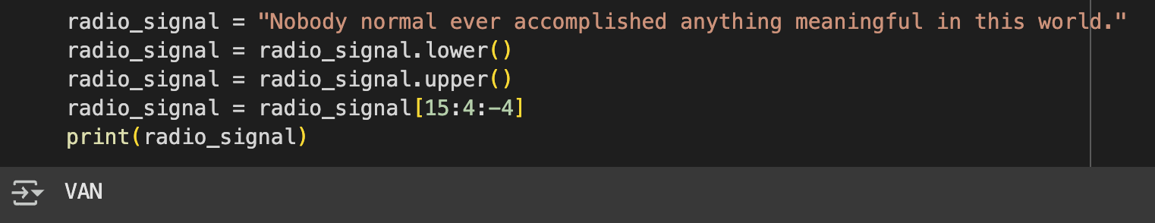
Dustin’s Secret Transmission · $500
What is the output?
Question board

Slide 9
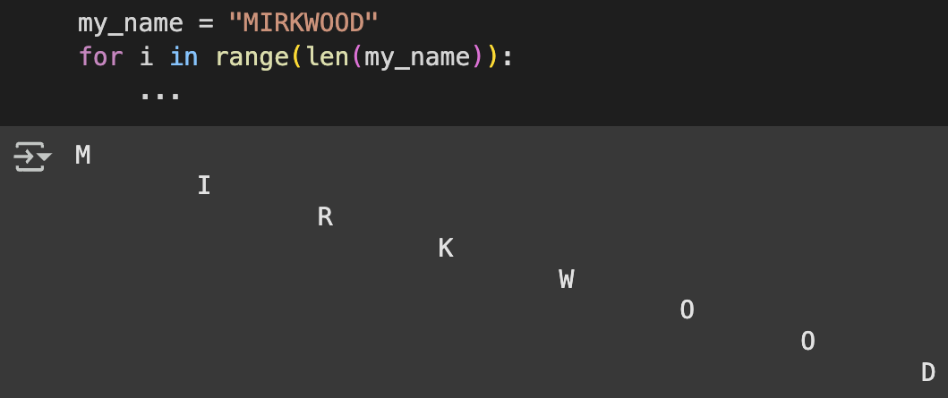
Cracking Eleven’s Code · $1000
Provide the print statement that will give this output?
Question board

Slide 10
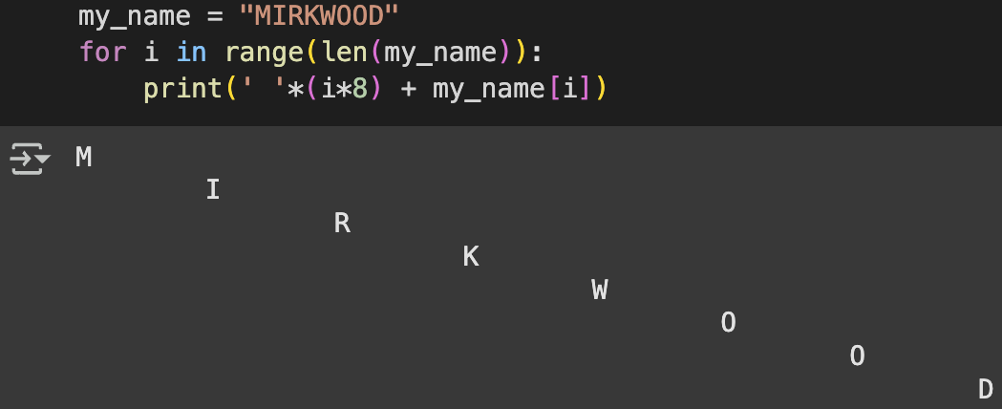
Cracking Eleven’s Code · $1000
Provide the print statement that will give this output?
Question board

Slide 11

Loop Wars
May the Loops & Logic Be With You

Slide 12
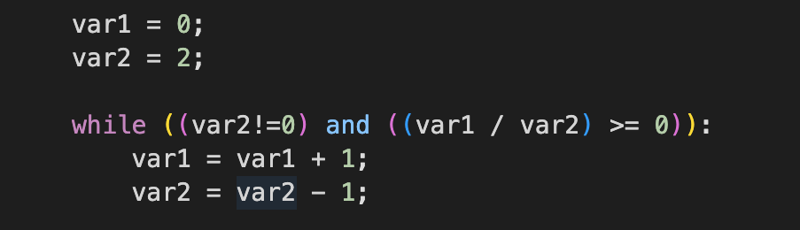
The Loop Awakens · $250
What are the values of var 1 and var 2 after the following code segment is executed and the while loop finishes?
Question board

Slide 13
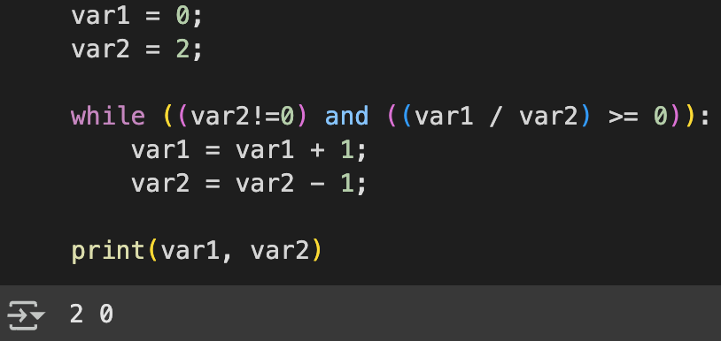
THE LOOP AWAKENS· $250
What are the values of var 1 and var 2 after the following code segment is executed and the while loop finishes?
Question board

Slide 14
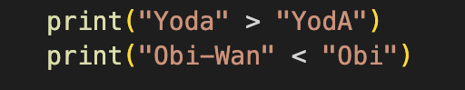
Duel of the Strings· $500
What is the output?
Question board

Slide 15
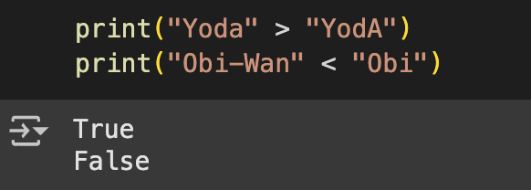
Duel of the Strings · $500
What is the output?
Question board

Slide 16
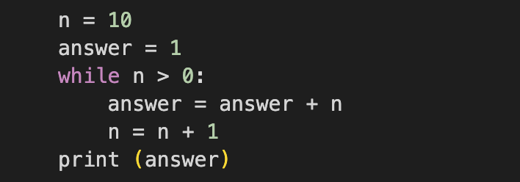
DARTH DEBUGGING · $1000
Verbally explain what happens in the following piece of code:
Question board

Slide 17
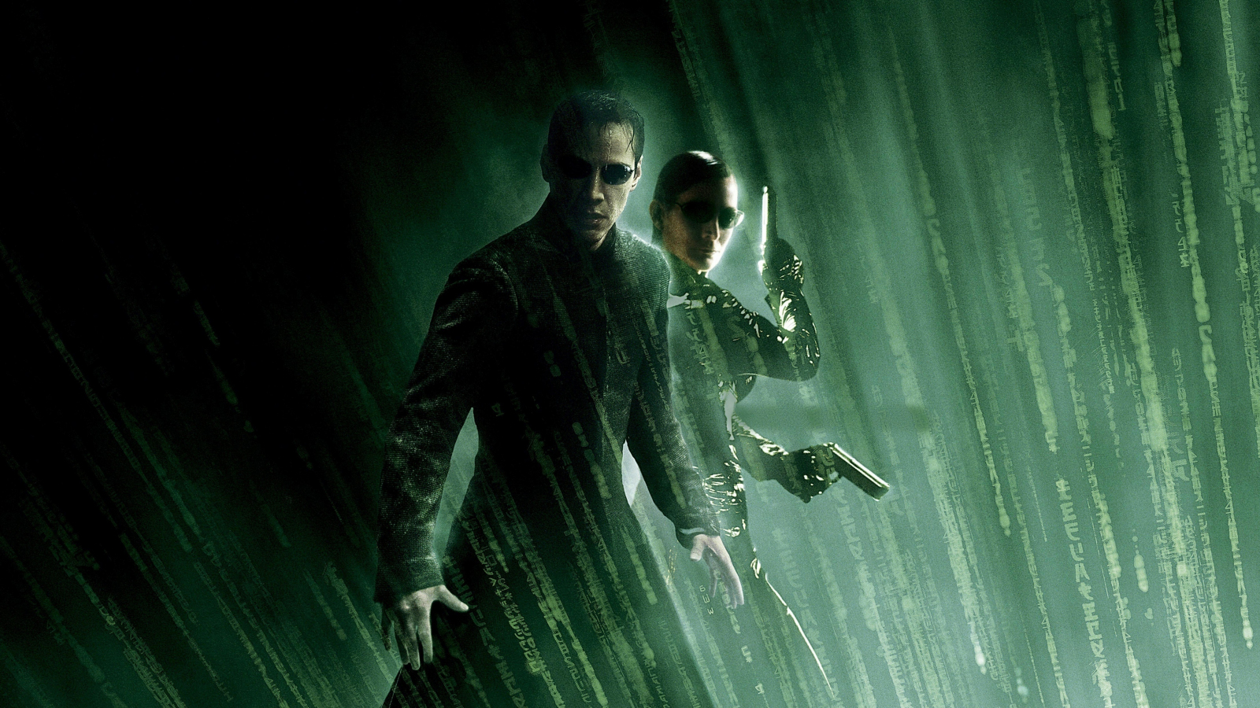
The Boolean Identity
The difference between knowing the truth… and living a lie.

Slide 18
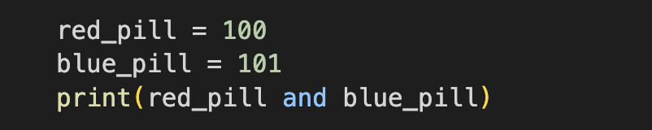
Red pill or blue pill? · $250
What is the Output?
Question board

Slide 19
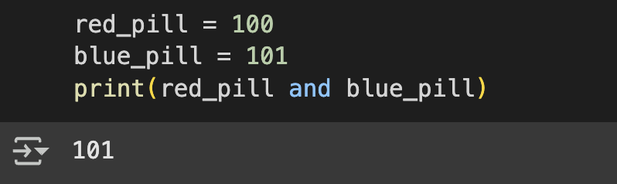
Red pill or blue pill? · $250
What is the Output?
Question board

Slide 20
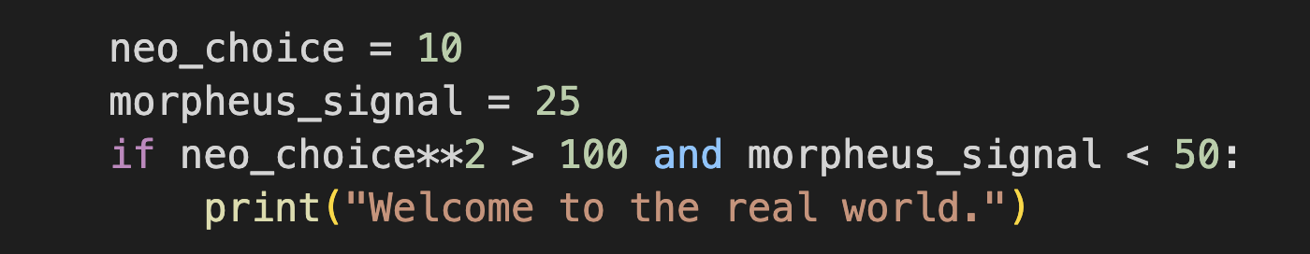
Agent Smith’s Logic Trap· $500
What is the Output?
Question board

Slide 21
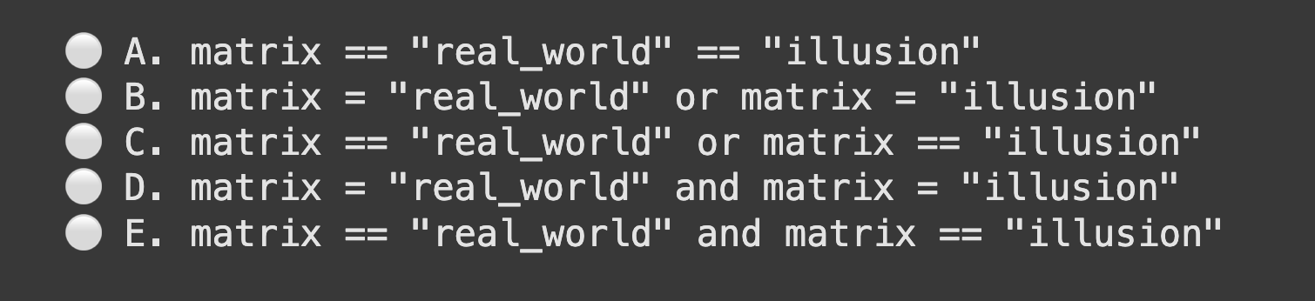
The One Condition · $1000
Which Boolean condition will evaluate True when matrix == "real_world" or matrix == "illusion"?
Question board

Slide 22
The One Condition · $1000
Which Boolean condition will evaluate True when matrix == "real_world" or matrix == "illusion"?
Question board

Slide 23

Every function needs structure—just like Gotham needs order.
The
Batcode Rises

Slide 24
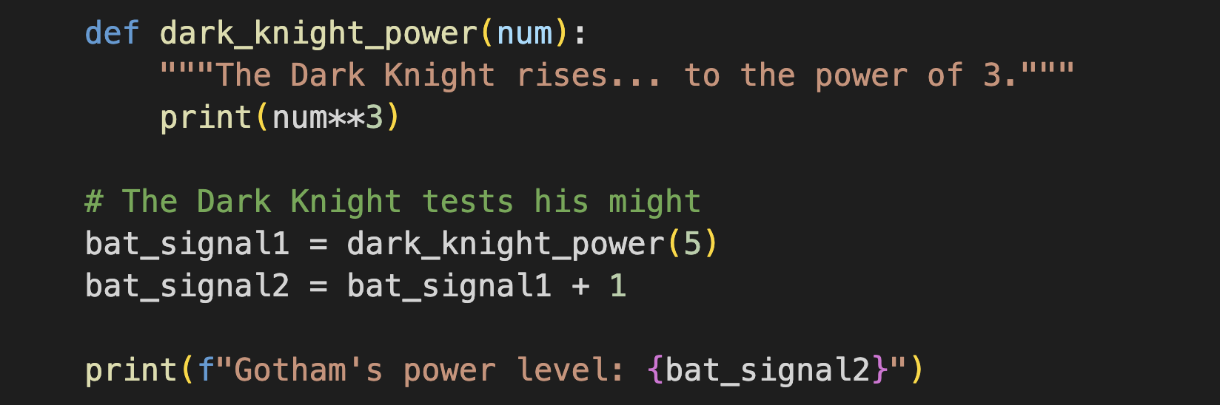
true power of the Dark Knight · $250
What is the outcome of executing this code?
Question board

Slide 25
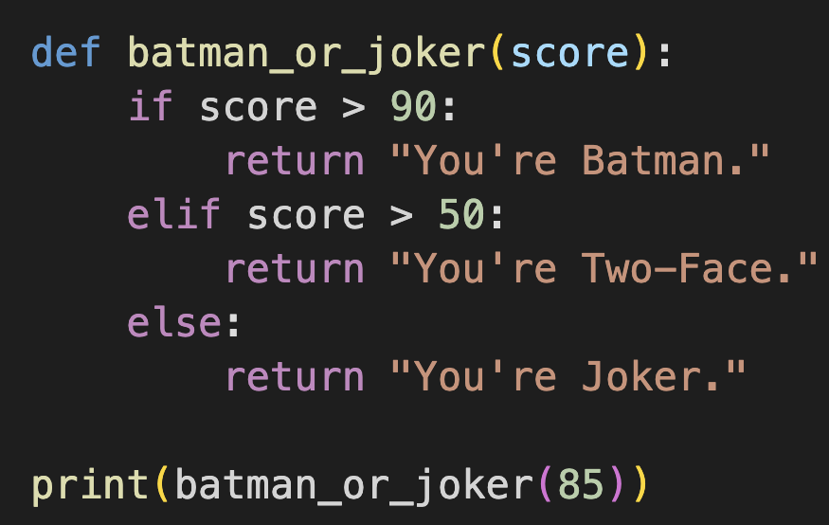
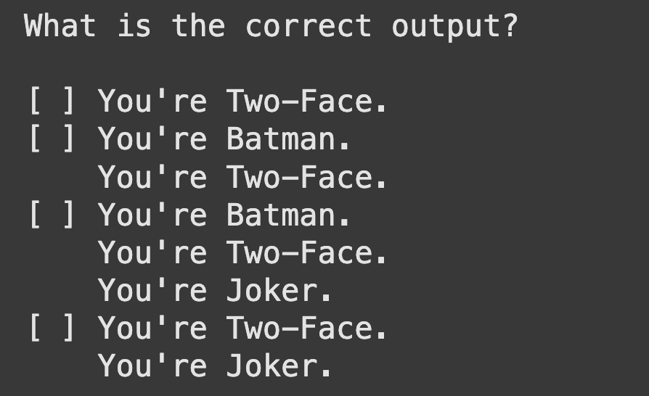
You Either Die a Hero · $500
What is the Output?
Question board

Slide 26
You Either Die a Hero · $500
What is the Output?
Question board

Slide 27
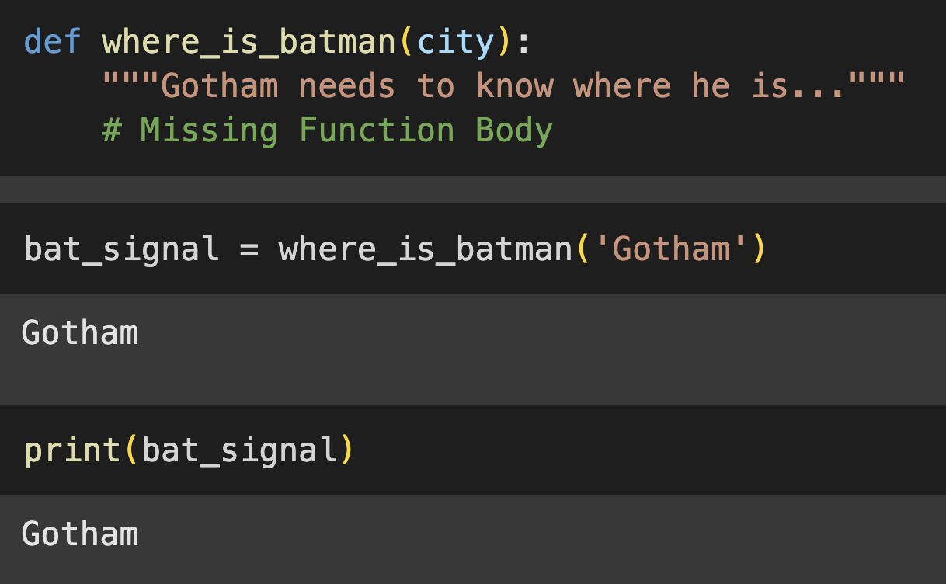
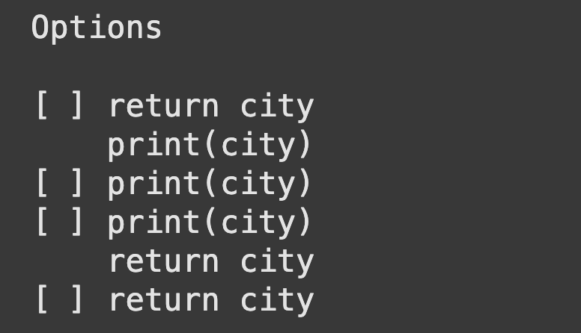
It's All Part of the Plan · $1000
Select the missing function body from the options below
Question board

Slide 28
It's All Part of the Plan· $1000
Select the missing function body from the options below
Question board

Slide 29

Mission:
DebugGING
Because every bug is a ticking time bomb… can you defuse it in time? ⏳💥

Slide 30
Operation Divide & Fall · $250
Mission Briefing:
A critical operation was executing when a secret code was asked to divide by zero. The system crashes. Identify the type of error before the mission fails.
Question board

Slide 31
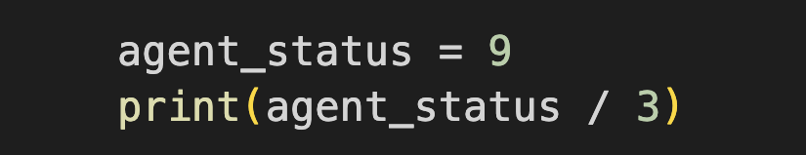
Undercover Syntax · $500
Will this code execute, or has it been sabotaged?
Question board

Slide 32
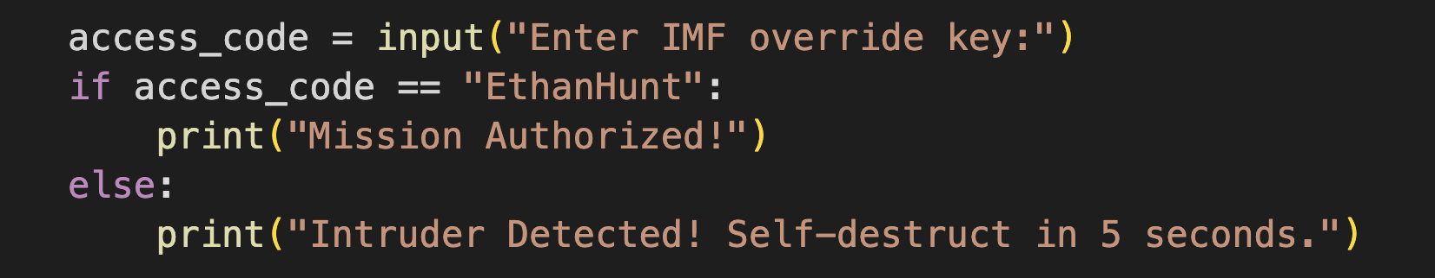
The Disavowed Input· $1000
What kind of error is that?
A hacker inputs “ethanhunt” and receives the response “Intruder Detected! Self-destruct in 5 seconds.”
Question board

Slide 33

Final
Jeopardy

Slide 34
Mastering the Ocean’s Flow
On Pandora, water changes depending on the environment.
At freezing temperatures, it becomes solid ice.
When the temperature is normal, it flows gently.
When it’s too hot, it turns into steam.
Your task:
Determine the state of Pandora’s water based on its temperature.
Write a function that determines whether Pandora’s water is ice, liquid, or steam based on temperature.
Question board

Slide 35
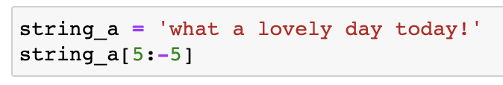
What is the output?
things and strings · $250
Question board

Slide 36
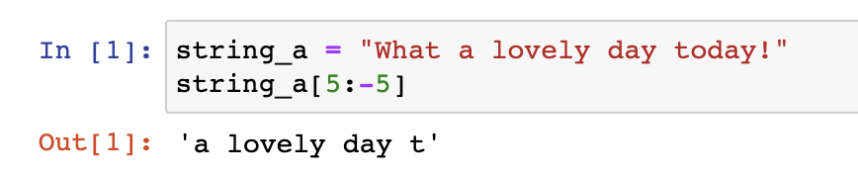
What is the output?
things and strings · $250
Question board

Slide 37
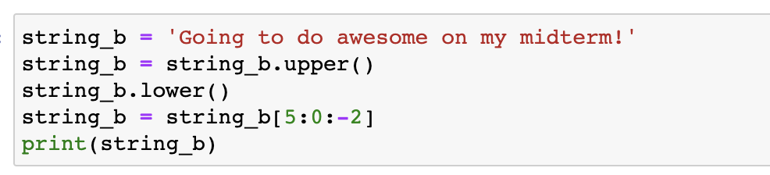
What is the output?
Things and strings · $500
Question board

Slide 38
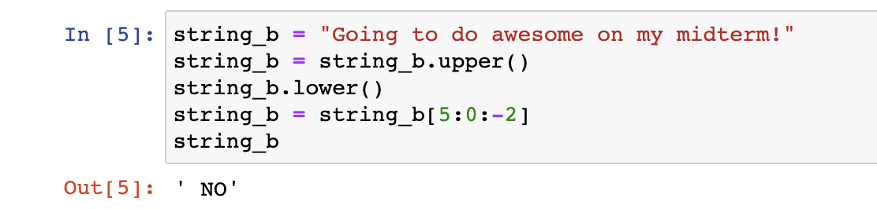
What is the output?
Things and strings · $500
Question board

Slide 39
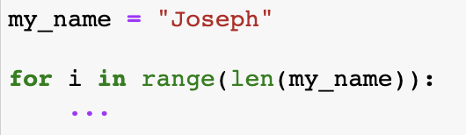
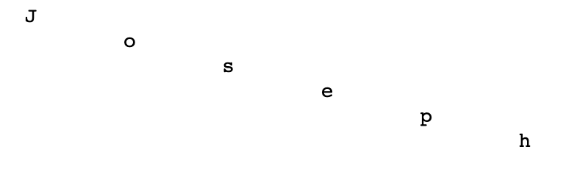
Provide the print statement that will give this output
Things and strings · $1000
Output:
Question board

Slide 40
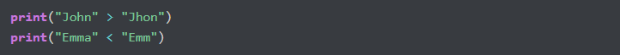
What is the output of the code?
TIME TO COMPARE AND GET LOOPY · $500
Question board

Slide 41
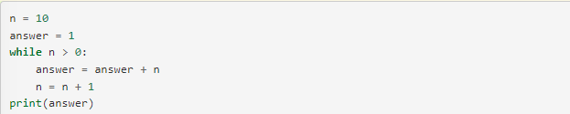
Verbally explain what happens in the following piece of code:
TIME TO COMPARE AND GET LOOPY · $1000
Question board

Slide 42
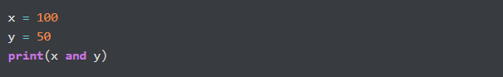
What is the output?
To AND OR NOT TO AND · $250
Question board

Slide 43
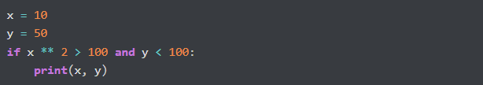
What is the output?
To AND OR NOT TO AND · $500
Question board

Slide 44
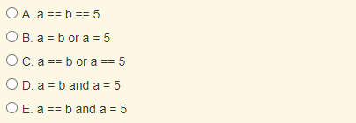
Which of the following evaluates to True when a is equal to b or when a is equal to 5?
To AND OR NOT TO AND · $1000
Question board

Slide 45
Which of the following evaluates to True when a is equal to b or when a is equal to 5?
To AND OR NOT TO AND · $1000
Question board

Slide 46
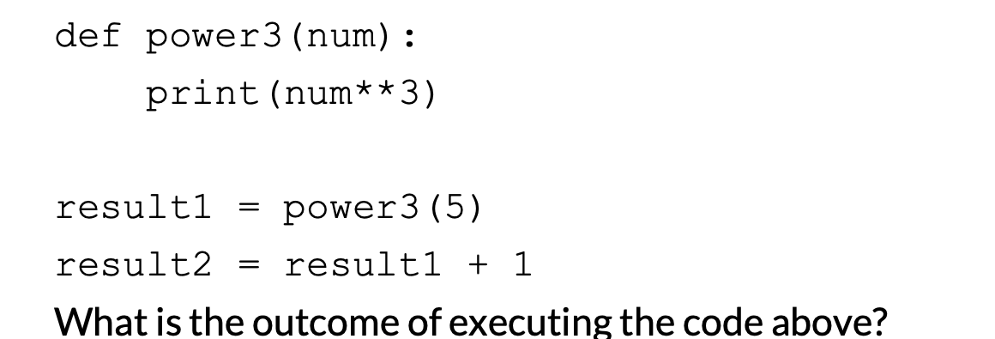
What is the output?
Get func-y with it · $250
Question board

Slide 47
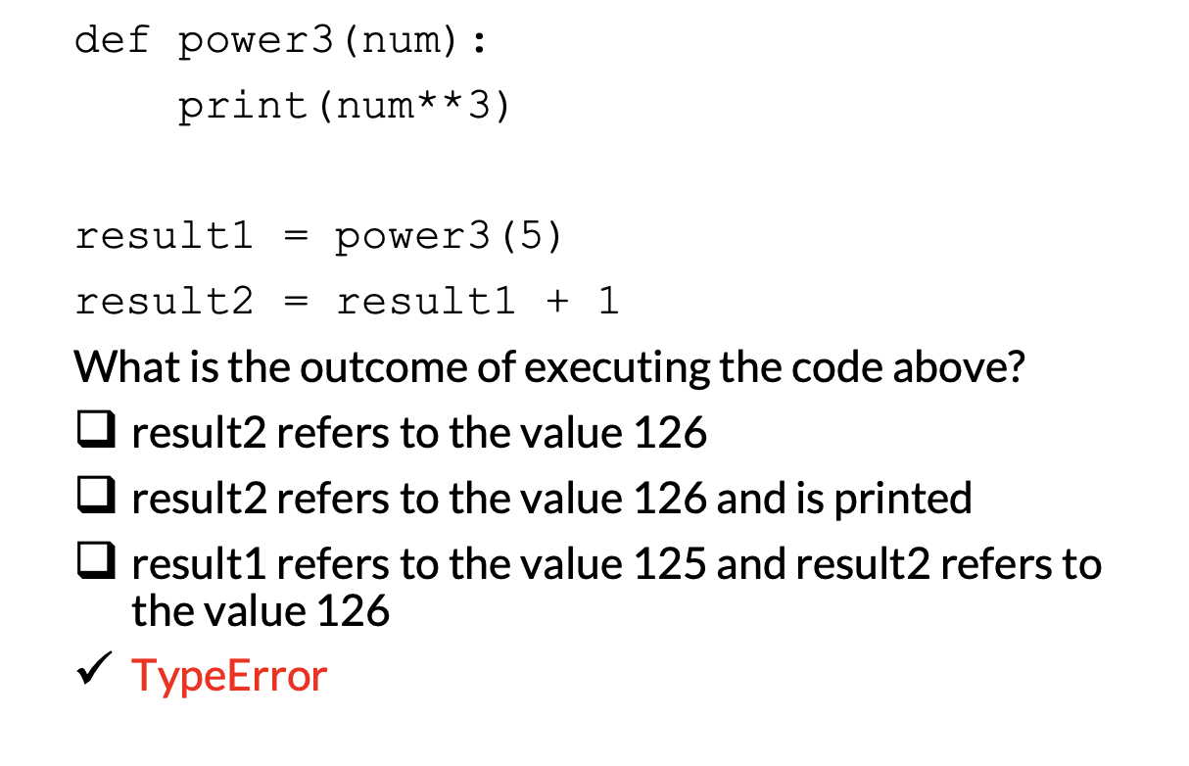
Get func-y with it · $250
Question board

Slide 48
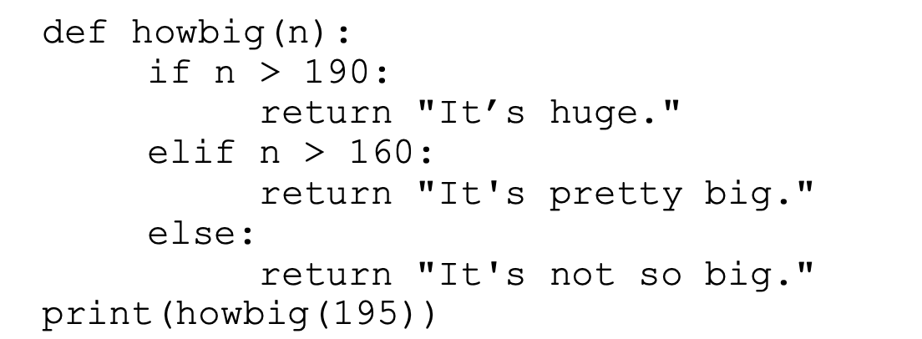
What is the output?
Get func-y with it · $500
Question board

Slide 49
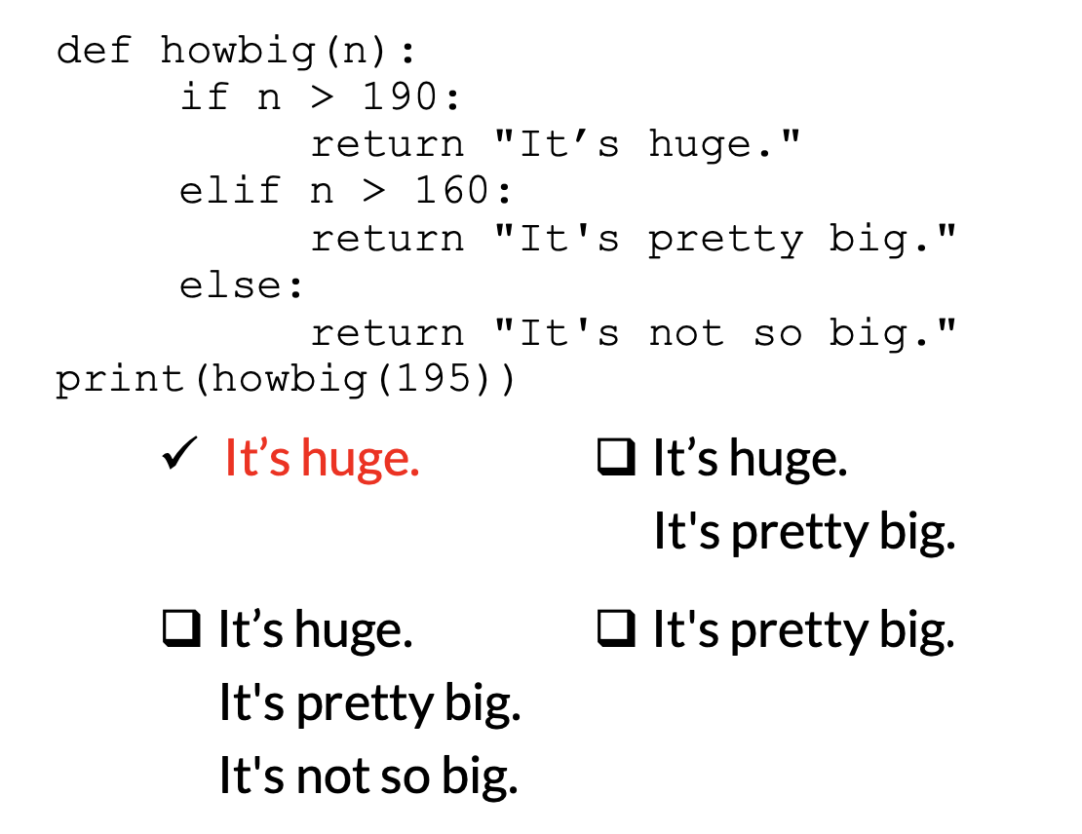
Get func-y with it · $500
Question board

Slide 50
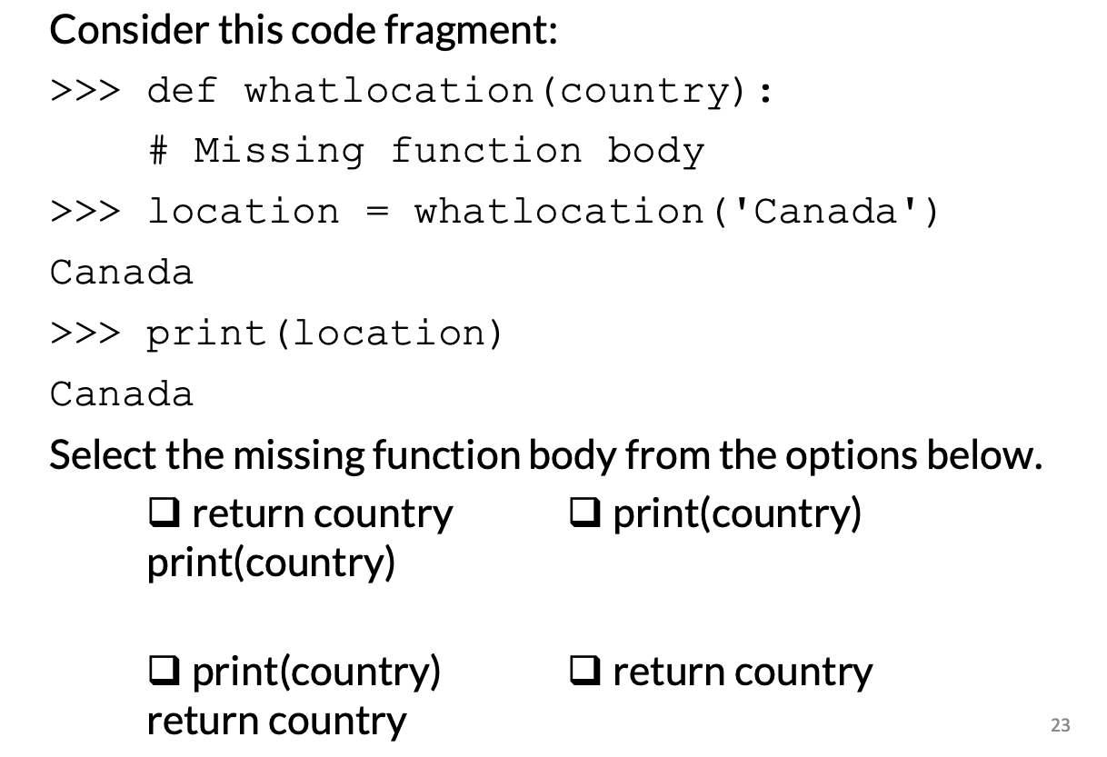
Get func-y with it · $1000
Question board

Slide 51
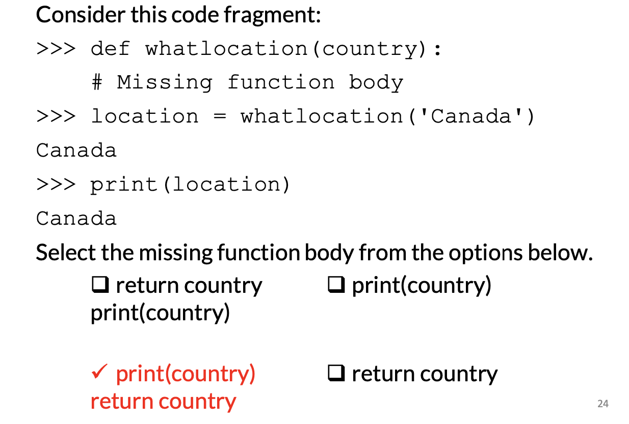
Get func-y with it · $1000
Question board

Slide 52
A program runs and, during running is asked to divide by zero. The program crashes. What type of error is this?
Err-ing on the side of caution · $250
Question board

Slide 53
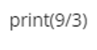
What will the output be from the following code?
Err-ing on the side of caution · $500
Question board

Slide 54
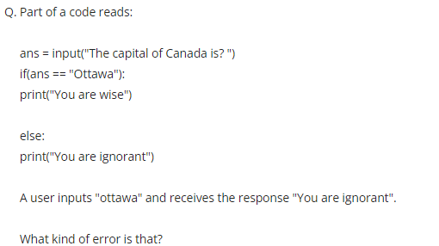
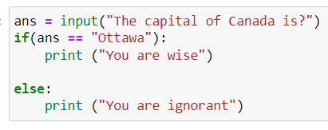
Err-ing on the side of caution · $1000
Question board

Slide 55
Water exists in three states- solid, liquid, and gas. Write a function that takes in the temperature in Celsius and returns a string “solid”, “liquid”, or “gas” depending on the temperature. Write a program using this function that prompts the user for a temperature and prints out the resulting state of water.
STATES OF MATTER · FINAL JEOPARDY

